Slide 1
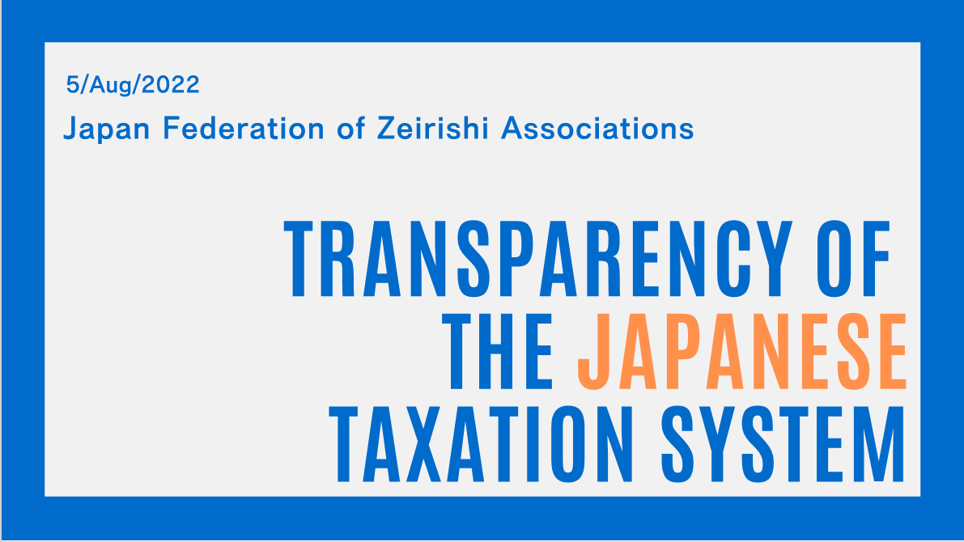

Slide 2
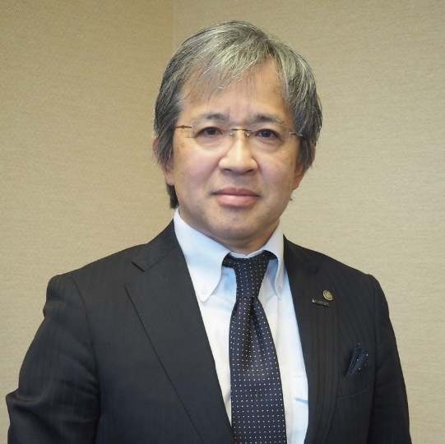

江本 尚浩
Naohiro Emoto
Executive Director
Chairman, International Relations Dept.
笹尾 博樹
Hiroki Sasao
Member, International Relations Dept.

Slide 3
Table of
Contents
International Development of Cross-Border Tax Filing
Development of Japanese Taxation System for Cross-Border Tax Filing

Slide 4
International Development of Cross-Border Tax Filing

Slide 5
1 Types of tax treaties, etc.
A tax treaty is generally concluded between the two countries or parties to address (ⅰ) international “avoidance of double taxation,” (ⅱ) “tax evasion,” and “tax avoidance, etc.” concerning cross-border income. Concerning tax treaties, the "OECD Model Tax Convention (on Income and Capital)" is regarded as an international standard. As a member nation of the OECD, the tax treaties concluded between Japan and other countries/regions have also adopted the provisions in line with this model convention.
Among such provisions, an agreement on the “exchange of taxpayer information (including confidential information of banks) between tax authorities” is included for addressing (ⅱ) "tax evasion" and "tax avoidance, etc.”
(1) The so-called tax treaties related to income tax or corporate tax

Slide 6
1 Types of tax treaties, etc.
Most tax treaties relate to income and corporate tax, but Japan has concluded the Inheritance Tax Treaty with the United States of America. To prevent tax fraud and tax evasion, both countries have agreed on the exchange of necessary information available under the respective taxation laws of each country.
(2) The so-called tax treaties related to inheritance tax
Japan is also promoting the conclusion of Tax Information Exchange Agreements with other countries and regions, which principally focus on exchanging information with tax haven jurisdictions. Unlike the conventional comprehensive tax treaty, which mainly aims at preventing double taxation between the two countries, the primary purpose of this Agreement is to promote the effectiveness of bilateral information exchange, etc., between the competent tax jurisdictions.
(3) Tax Information Exchange Agreement

Slide 7
1 Types of tax treaties, etc.
This Convention entered into force for Japan on October 1, 2013, which deals not only with the issues of income tax and corporate tax but also with many other tax items, including gift and inheritance taxes.
Under the Convention, the tax authorities of signing parties※ provide administrative assistance in tax matters, such as (ⅰ) exchange of information, (ⅱ) mutual assistance in the tax collection, and (ⅲ) mutual assistance in delivering tax-related documents, to adequately address international tax evasion and tax avoidance.
(4) The Convention on Mutual Administrative Assistance in Tax Matters
※ As of June 10, 2021, 137 countries have signed the Convention.

Slide 8
1 Types of tax treaties, etc.
To implement various recommendations developed through the Base Erosion and Profit Shifting (BEPS) Action Plan, this multilateral convention was developed※ to improve efficiency in tax matters instead of revising many bilateral tax treaties worldwide.
(5) Multilateral Convention to Implement Tax Treaty Related Measures to Prevent Base Erosion and Profit Shifting
※ The Convention was enforced for Japan on January 1, 2019.
As of April 20, 2021, 93 countries have signed the Convention.

Slide 9
2 Exchange of Information under Tax Treaties, etc.
When a taxation authority conducts tax investigations of specific taxpayers and the information obtained through their procedures is insufficient to clarify the facts, they request the Convention partner country, etc. to collect and provide the necessary information.
(1) Exchange of information upon request
Information, etc. that can be obtained from tax authorities of other countries
Include financial statements and tax return filings of overseas corporations, registration information, articles of incorporation, companies’ officer-information, contracts, bank deposit accounts, hearings of taxpayers in the partner country prepared by the authorities of the partner country, etc.

Slide 10
2 Exchange of Information under Tax Treaties, etc.
Voluntary provision of information collected during the investigation of taxpayers in their own country for the use of the tax authority of another partner country, such as a member country of the treaty.
(2) Voluntary exchange of information
Information on payments to non-residents, etc., obtained from legal records, etc., is sent collectively from the tax authority of the paying country to the counterpart of the receiving country, which is a member nation of the treaty.
The National Tax Agency (NTA) of Japan uses information from foreign countries to investigate income tax and inheritance tax payable from Japanese residents, based on the information on interest and dividends paid from foreign financial institutions.
(3) Automatic exchange of information

Slide 11
2 Exchange of Information under Tax Treaties, etc.
To implement various recommendations developed through the Base Erosion and
Profit Shifting (BEPS) Action Plan, the National Tax Agency started an automatic exchange of the financial account information of a non-resident (CRS information) according to the Common Reporting Standard (CRS) under the provisions of the Tax Information Exchange Agreement.
(4) Reporting System for Automatic Exchange of Financial Account Information of Non-Residents (CRS)

Slide 12
2 Exchange of Information under Tax Treaties, etc.
(ⅰ) Exchange of the information under the conventional system
(5) Number of information exchanges in FY2020

Slide 13
2 Exchange of Information under Tax Treaties, etc.
(ⅱ) Receipts and provisions of CRS information
(Receipts and Provisions for FY 2018)
(5) Number of information exchanges in FY2020

Slide 14
2 Exchange of Information under Tax Treaties, etc.
NTA has publicized the "Procedures for Information Exchange and Mutual Assistance of Service with Partner Countries, etc., under Tax Treaties, etc. (Administrative Guidelines)." The Administrative Guidelines provide guidance on the administrative procedures for the exchange of specific information and voluntary exchange of information according to the provisions of information exchange under tax treaties to streamline the administrative processes for promoting the exchange of information with partner countries.
(6) Administrative guidelines on the procedures of information exchange

Slide 15
3 Joint International Taskforce on Shared Intelligence and Collaboration (JITSIC)
JITSIC is an organization participated by 42 countries, including OECD member nations. Through the exchange of information under tax treaties, etc., JITSIC members share knowledge and information on solutions and investigation methods, etc. with the other participating countries to address international tax avoidance schemes and to correspond to the requests for information exchange related to high net worth individuals, etc.
(6) Administrative Guidelines for Information Exchange Procedures
Membership
The JITSIC is open on a voluntary basis to members of the Forum on Tax Administration. The current members are:
(3) Automatic exchange of information

Slide 16
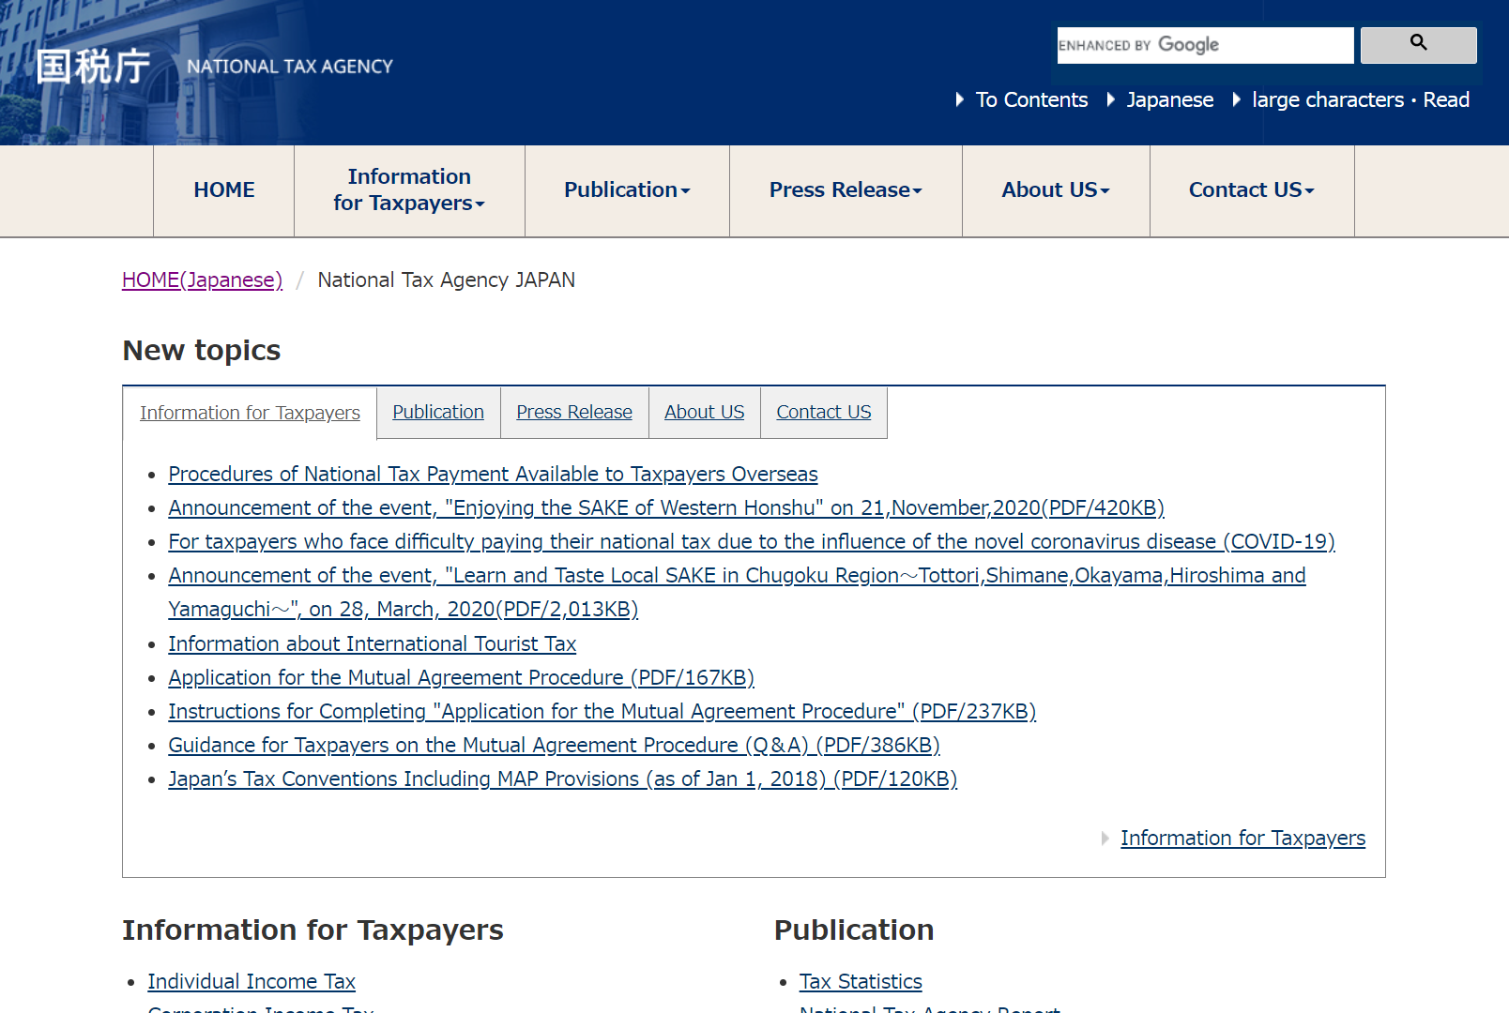

4 Participation in international conferences held tax authorities
To address the problem of double taxation on the same income by multiple countries along with the advanced internationalization of the economy, as well as solving the “double non-taxation” where the concerned income is not taxed in any country due to tax avoidance behaviors, NTA participates in various international conferences, including ① OECD Forum on Tax Administration, ② Study Group on Asian Tax Administration and Research, and ③ OECD Committee on Fiscal Affairs.
(3) Automatic exchange of information
イータ君
IRS e-Tax Character
https://www.nta.go.jp/english/index.htm

Slide 17
Japan's Tax Treaty Network
Europe（46）
Iceland／Ireland／United Kingdom／
Italy／Estonia／Austria／Netherlands／Croatia／Switzerland／Sweden／
Spain／Slovakia／Serbia／
Czech Republic／Denmark／
Germany／Norway／Hungary／
Finland／France／Bulgaria／Belgium／Portugal／Poland／Latvia／Lithuania／Luxembourg／Romania／
Bailiwick of Guernsey／
Bailiwick of Jersey／Isle of Man／Liechtenstein
＜Execution Deduction Treaty only＞
Albania／Andorra／
North Macedonia／Cyprus／
Greece／Greenland／San Marino／
Gibraltar／Faroe Islands／
Bosnia and Herzegovina／Malta／
Monaco／Montenegro
Russian＆NIS countries（12）
Azerbaijan／Armenia／Ukraine／Uzbekistan／Kazakhstan／Kyrgyzstan／Georgia／Tajikistan／Turkmenistan／Belarus／Republic of Moldova／Russian Federation
North America
&Latin America（35）
United States of America／Uruguay／Ecuador／Canada／Jamaica／Chile／Brazil／Peru／Mexico／Cayman Islands／
British Virgin Islands／Panama／Bahamas／Bermuda
＜Execution Deduction Treaty only＞
Argentina／Aruba／Anguilla／Antigua and Barbuda／El Salvador／Curacao／Guatemala／Grenada／Costa Rica／Colombia／
Saint Kitts and Nevis／
Saint Vincent and the Grenadines／Saint Martin／Saint Lucia／
Turks and Caicos Islands／Dominican Republic／Dominica／Paraguay／Barbados／Belize／Montserrat
● Tax treaty
● Information exchange agreement
● Tax Administration Enforcement
Mutual Aid Treaty only
● Taiwan-Japan Private Sector Tax
Arrangement
Africa（18）
Egypt／Zambia／South Africa
＜Execution Deduction Treaty only＞
Uganda／Eswatini／Ghana／
Cabo Verde／Cameroon／Kenya／Seychelles／Senegal／Tunisia／Nigeria／Namibia／Botswana／Mauritius／Morocco／Liberia
Asia & Oceania（28）
India／Indonesia／Australia／Republic of Korea／Singapore／Sri Lanka／Thailand／ China／New Zealand／Pakistan／Bangladesh／Fiji／Philippines／Brunei Darussalam／Viet Nam／Hong Kong／Malaysia／Samoa／Macau／Taiwan
＜Execution Deduction Treaty only＞
Cook Islands／Nauru／Niue／New Caledonia／Vanuatu／Marshall Islands／Maldives／Mongolia
Middle East（10）
United Arab Emirates／Israel／Oman／Qatar／Kuwait／Saudi Arabia／Turkey
＜Execution Deduction Treaty only＞
Bahrain／Jordan／Lebanon

Slide 18
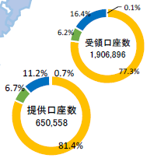
CRS Information by Region Number of Accounts Accepted/Provided
Europe＆NIS countries（45）
Iceland | Gibraltar | Greece | Czech Republic | France | Lithuania
Ireland | Bailiwick of Jersey | Croatia | Denmark | Bulgaria | Liechtenstein
Azerbaijan | Isle of Man | San Marino | Greenland | Belgium | Romania
Albania | Estonia | Switzerland | Faroe Islands | Poland | Luxembourg
Andorra | Austria | Sweden | Germany | Portugal | Russian Federation
Italy | Netherlands | Spain | Norway | Malta
United Kingdom | Kazakhstan | Slovakia | Hungary | Monaco
Bailiwick of Guernsey | Cyprus | Slovenia | Finland | Latvia
North America&Latin America（28）
Argentina | Saint Kitts and Nevis
Antigua and Barbuda | Saint Vincent and the Grenadines
Uruguay | Saint Lucia
Anguilla | Chile
British Virgin Islands | Dominica
Cayman Islands | Panama
Turks and Caicos Islands | Bahamas
Bermuda | Barbados
Montserrat | Brazil
Ecuador | Belize
Canada | Peru
Grenada | Mexico
Costa Rica | Aruba
Colombia | Curacao
Europe＆NIS countries
Accepted：313,587（40）
Provided：73,074（39）
Middle East & Africa（14）
United Arab Emirates
Israel
Oman
Qatar
Ghana
Kuwait
Saudi Arabia
Seychelles
Turkey
Nigeria
Bahrain
South Africa
Mauritius
Lebanon
North America
&Latin America（28）
Accepted：117,291（19）
Provided： 43,354（13）
Number of Accounts Accepted
Middle East & Africa
Accepted：2,818（12）
Provided：4,266（６）
Asia & Oceania
Accepted：1,473,200（16）
Provided：529,864（12）
Asia & Oceania（19）
India | Samoa | China | New Zealand | Brunei Darussalam
Indonesia | Singapore | Hong Kong | Pakistan | Marshall Islands
Australia | Republic of Korea | Macau | Vanuatu | Malaysia
Cook Islands | Taiwan | Nauru | New Caledonia
Number of Accounts Provided

Slide 19
Ⅱ. Development of Japanese Taxation System for Cross-Border Tax Filing

Slide 20
Development of the reporting scheme for records of remittances and receipts related to foreign countries
To ensure fair taxation, such as inheritance tax as well as income tax and corporate tax, the Japanese taxation system has been promoting the improvement of the tax filing procedures by introducing the following scheme under the Act on Submission of Statement of Overseas Wire Transfers for Purpose of Securing Proper Domestic Taxation (hereinafter, referred to as the “Records of remittances and receipts related to foreign countries”) to prevent hiding assets overseas and international tax evasion.

Slide 21
1 Report of the records of remittances and receipts related to foreign countries
Scope of “remittances and receipts related to foreign countries” under the reporting scheme
The following “overseas outward remittance” and “receipt of overseas inward remittance, etc.” are eligible.
Overseas outward remittance
Payment from Japan to a foreign country made by foreign exchange transactions performed by a financial institution
Receipt of a payment from a foreign country to Japan made by foreign exchange transactions performed by a financial institution, or the receipt of a check, a bill of exchange, or a consideration for appraisal of other equivalent instruments performed by a financial institution
Receipt of overseas inward remittance, etc.

Slide 22
1 Report of the records of remittances and receipts related to foreign countries
(2) Submission of the written notice
A person who performs an overseas remittance, etc., must submit a written notice
stating full name, address, and other information to the head of the financial institution's
branch office, etc.,
(3) Submission of the records of remittances and receipts related to foreign countries
(ⅰ) Obligation to submit the records
A financial institution must submit a "record of overseas remittance, etc." for each overseas remittance, etc., conducted by its customer through foreign exchange transactions performed by the financial institution’s branch office, etc.
(ⅱ) Transaction amount that must be reported
The overseas remittance, etc. of over 1,000,000 yen.

Slide 23
1 Report of the records of remittances and receipts related to foreign countries
(3) Submission of the records of remittances and receipts related to foreign countries
(ⅲ) Items to be stated on the records
In the case of sending “overseas outward remittance”
The customer's full name (or business name) and address, the amount of remittance shipped overseas, the reason for the remittance as stated on the written notice, and other specific matters.
In the case of receiving “overseas inward remittance, etc.”
The customer's full name (or business name) and address, the amount of remittance received from overseas, the type and number, etc. of the client’s account receiving the remittance, and other specific matters.

Slide 24
1 Report of the records of remittances and receipts related to foreign countries
(3) Submission of the records of remittances and receipts related to foreign countries
(ⅳ) The office to which the records are to be submitted
The district director of the tax office in the jurisdiction of the financial institution’s branch office, which performed foreign exchange transactions for overseas remittances, etc., is located.
(ⅴ) Submission due date
The last day of the month following the month including the date of foreign exchange transactions for overseas remittance, etc.

Slide 25
2 System for Reporting of Overseas Securities Transfers, etc.
(1) Scope of “securities transfer, etc. related to foreign countries” under the reporting scheme
The following “cross-border securities transfer” and “cross-border securities acceptance” are subject to this scheme.
Transfer of securities by a financial instruments business operator, etc., upon the customer’s request, from a securities account in Japan to a securities account in a foreign country.
Cross-border securities transfer
Cross-border securities acceptance
Acceptance of securities by a financial instruments business operator, etc., upon the customer’s request, from securities account in a foreign country to securities account in Japan.

Slide 26
2 System for Reporting of Overseas Securities Transfers, etc.
(2) Submission of the written notice
A person who requests the cross-border transfer of owned securities, etc., to the head of the financial instruments business operator’s branch office, etc., must submit a written notice stating their full name, address, and other information to the head of the financial instruments business operator.

Slide 27
2 System for Reporting of Overseas Securities Transfers, etc.
(3) Submission of the records of security transfer, etc. related to foreign countries
A financial instruments business operator, etc., must submit a "record of security transfer, etc. related to foreign countries" for each cross-border transfer, etc. of securities performed at the request of its customer.
Obligation to submit the records
The customer’s full name (or business name) and address, the type and name of securities transferred overseas, and other specific matters
Items to be stated on the records
The director of the district tax office in the jurisdiction for the domicile of the financial instrument business operator’s branch office, etc., which performed cross-border securities transfers, etc.
The office to which the records are to be submitted
Submission due date
By the last day of the month following the month, including the date when cross-border securities transfer, etc., was made.

Slide 28
3 Report of Foreign Asset Statements
A Japanese resident with assets in foreign countries that exceed over 50 million yen as of December 31 of the year must submit the Foreign Asset Statement by March 15 of the following year to the director of the district tax office.
(1) Person subject to reporting obligations
A resident of Japan other than a non-permanent resident as stipulated under the Income Tax Act has assets held overseas that exceed over 50 million yen as of December 31 of the year.

Slide 29
3 Report of Foreign Asset Statements
(2) Definition of foreign assets
“Foreign assets” mean the “assets located outside of Japan. “
Whether the assets are located outside of Japan or not
According to the provisions of the location of assets under Article 10 of the Inheritance tax Act in principle.
Decision of the location of foreign assets
Based on the current status as of December 31
(3) Valuation under the Foreign Assets Statements scheme
The market value determines the value of foreign assets as of December 31 of the year or the value specified as equivalent to the market value by the Ordinance of the Ministry of Finance.
Convert the value of foreign assets into Japanese yen at the foreign currency exchange rate as of December 31 of the year (precisely, the Telegraphic Transfer Buying (TTB) rate or the equivalent rate).
Valuation of foreign assets

Slide 30
3 Report of Foreign Asset Statements
(4) Relief and aggravation measures to the additional tax
(3) Automatic exchange of information
If income tax or inheritance tax return filings remain undeclared/underestimated for the foreign assets stated on the Statement submitted within the submission deadline, and additional tax for deficient declaration or additional tax for non-declaration is applied, deduct the amount equivalent to 5% of the tax amount used as the basis of calculation from the additional tax on the foreign assets.
relief measure
If the Foreign Asset Statement is not submitted within the submission deadline, or if income tax return filing remains undeclared for the foreign assets not stated in the submitted Statement and additional tax for deficient declaration or additional tax for non-declaration is applied, add the amount equivalent to 5% of the tax amount used as the basis of calculation to the additional tax on the foreign assets.
(Note) Unlike the relief measure for additional tax, the provisions of aggravation measure do not apply to inheritance tax and income tax on the deceased person.
Aggravation measure

Slide 31
3 Report of Foreign Asset Statements
(5) Submission of Foreign Asset Statements
*The posted figures are partially edited from the NTA website.

Slide 32
3 Report of Foreign Asset Statements
(5) Submission of Foreign Asset Statements
*The posted figures are partially edited from the NTA website.

Slide 33
3 Report of Foreign Asset Statements
(5) Submission of Foreign Asset Statements
*The posted figures are partially edited from the NTA website.

Slide 34
4 Report of the Statement of Assets and Liabilities
(1) Reporting obligations
A person who is required to file an income tax return and is subject to the following (2) reporting obligations must submit the Statement of Assets and liabilities to the competent taxation authority.
(2) Person or entity subject to reporting obligations
Those who satisfy all the following requirements※ are subject to report the Statement of Assets and Liabilities.
    The person whose total amount of gross income and timber income for the year exceeds 20 million yen
    The person who has a property with a total value of 300 million yen or more or property subject to the special cases for exit from Japan (See III.3-1 (1)) with a total value of 100 million yen or more as of December 31 of the year
※ FY2022 taxation reform added a resident who has a total amount of assets with the value of one billion yen or more as of December 31 of the year for the filing from 2023 and later. The submission deadline was also amended to June 30 (The submission deadline for the Foreign Asset Statement was also amended as the same.)

Slide 35
4 Report of the Statement of Assets and Liabilities
(3) Items to be described on the Statement of Assets and Liabilities
The person's name, address (or place of residence) and Individual Number (for those who do not have an Individual Number, the name, address (or place of residence) and the type, quantity, and value of assets, the amounts of liabilities that the person has on the same day, as well as other specific matters.
(4) Values of Assets and Liabilities
Determined by the market value as of December 31 of the year or the value specified as equivalent to the market value by the Ordinance of the Ministry of Finance (The acquisition value is additionally required for securities, etc.)
Assets
Liabilities
Determined by the current status as of December 31 of the year

Slide 36
4 Report of the Statement of Assets and Liabilities
(5) The office to which documents are to be submitted
To the director of the district tax office for filing the taxpayer’s income tax payment
(6) Submission due date
By March 15 of the following year
(7) If the taxpayer is obliged to submit both the Statement of Assets and Liabilities and the Foreign Asset Statement
The matters concerning assets that should be described on the Foreign Asset Statement are not required to be noted on the Statement of Assets and Liabilities.
Regarding the Statement of Assets and Liabilities, the matters described on the assets and liabilities are subject to the measures of reduction and aggravation to additional tax, same as described in 3 Report of Foreign Asset Statements(4).
(8) Relief and aggravation measures to the additional tax

Slide 37
The measure related to efficient use of deposit and savings information with My Number
Regarding the “Individual Number for Social Security and Tax ( My Number) ” system, which started in January 2016, banks, etc., are obliged to manage the deposit information of their clients under the environment that is traceable by My Number, following the amendment of the Act on General Rules for National Taxes. Depositors will also need to notify their My Number to their banks, etc., but for the time being, such notification to the banks, etc., is not a legal obligation.

Slide 38

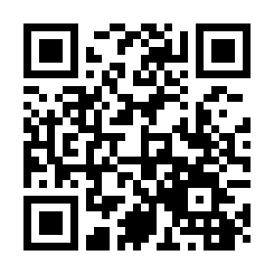
日本税理士会連合会
Japan Federation of Zeirishi Associations
https://www.nichizeiren.or.jp/eng/

